Slide 1

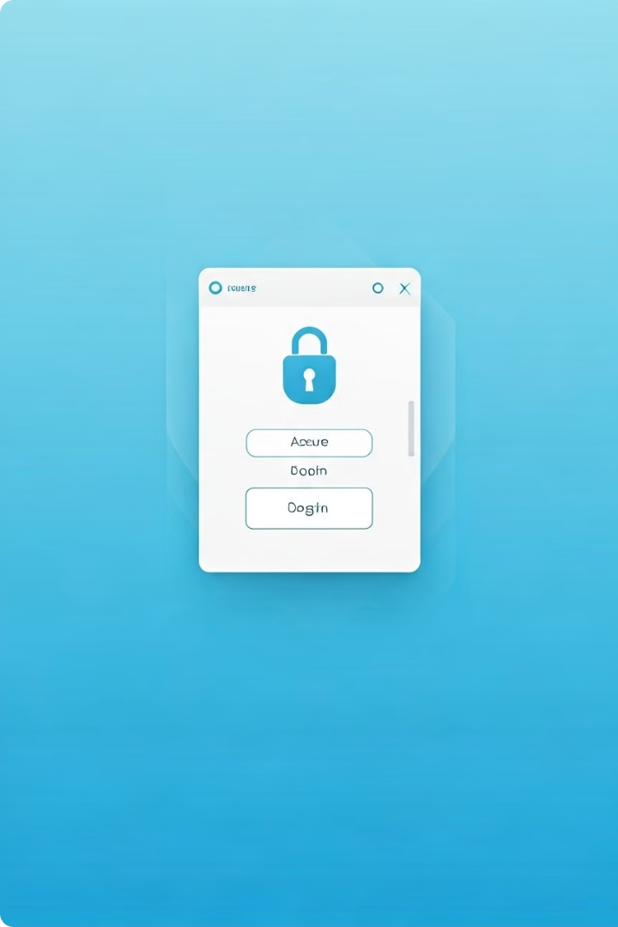
Introduction to Azure Multifactor Authentication (MFA)
Azure Multifactor Authentication (MFA) is a powerful security feature that adds an extra layer of protection to your Azure Active Directory accounts. By requiring users to provide two or more verification methods during the login process, MFA significantly reduces the risk of unauthorized access and helps safeguard your organization's sensitive data. This introduction will provide an overview of the key benefits and configuration steps for enabling MFA in your Azure environment.

Slide 2
Benefits of Enabling MFA
Improved Security
Reduced Risk of Breaches
Regulatory Compliance
MFA adds an extra layer of security by requiring users to provide additional verification, such as a one-time code or biometric authentication, in addition to their username and password. This makes it much harder for attackers to gain unauthorized access, even if they have obtained valid login credentials.
Weak or compromised passwords are a leading cause of data breaches. By implementing MFA, you can significantly reduce the risk of successful password-based attacks, protecting your organization's sensitive information and critical resources.
Many industry regulations and standards, such as HIPAA, PCI-DSS, and GDPR, require the use of MFA for access to certain systems and data. Enabling MFA can help your organization meet these compliance requirements and avoid costly penalties.

Slide 3

Configuring MFA for Azure AD Users
1
Step 1: Enable MFA
Begin by enabling Azure AD MFA for your organization. This can be done through the Azure portal or using PowerShell cmdlets. You can choose to enable MFA for all users or target specific groups or users based on your security requirements.
2
Step 2: Configure Authentication Methods
Once MFA is enabled, you can configure the available authentication methods for your users, such as phone calls, SMS, mobile app notifications, or hardware security keys. Users will be prompted to set up their preferred authentication method during their next login.
3
Step 3: Monitor and Manage
Regularly monitor MFA usage and activity to ensure that your users are adopting the new security measures and to identify any potential issues or security concerns. You can also adjust MFA settings and policies as needed to meet changing organizational requirements.

Slide 4

Enabling MFA for Azure AD Administrators
1
Prioritize Administrator Accounts
Enabling MFA for Azure AD administrator accounts should be a top priority, as these accounts have elevated privileges and access to critical resources. Doing so helps minimize the risk of unauthorized access and potential data breaches.
2
Enforce Strong Authentication
Require administrators to use strong authentication methods, such as biometrics or hardware security keys, to further enhance the security of their accounts. This provides an additional layer of protection beyond just a password.
3
Implement Conditional Access
Use Conditional Access policies to enforce MFA for administrator accounts, ensuring that users must complete the additional verification step before they can access sensitive resources or perform critical actions.
4
Regularly Review and Update
Continuously monitor and review the MFA configuration for administrator accounts, making updates as needed to address evolving security threats and organizational changes.

Slide 5

Enabling MFA for Azure AD Guest Users
Secure External Collaboration
Azure AD guest users, often used for external collaboration and partner access, pose a unique security challenge. Enabling MFA for these accounts can help ensure that only authorized individuals can access your organization's resources, even from outside your network.
Consistent Security Enforcement
Applying the same MFA requirements to guest users as you do for your internal employees helps maintain a consistent security posture across your organization, regardless of the user's affiliation or location.
Granular Access Control
By enabling MFA for guest users, you can implement more granular access control policies, such as restricting access to specific applications or data based on the user's verification method or location.
Reduced Risk of Compromise
Guest user accounts are often more vulnerable to compromise, as they may not be subject to the same security measures as internal employee accounts. Enabling MFA can significantly reduce the risk of unauthorized access to your organization's resources.

Slide 6





Configuring MFA Settings for Your Organization
Customize Authentication Methods
Set Policies and Enforcement
Monitor and Analyze Usage
Ensure Organizational Security
Establish MFA policies that determine which users or groups are required to use MFA, the frequency of re-authentication, and any conditional access rules that should be applied.
Regularly review MFA usage and activity data to identify any suspicious behavior, monitor user adoption, and make informed decisions about adjusting your MFA configuration and policies.
Configure the available authentication methods for your users, such as phone calls, SMS, mobile app notifications, or hardware security keys, to ensure a seamless user experience and meet your organization's specific security requirements.
Continuously evaluate and update your MFA settings to address evolving security threats, changes in your organization's structure or requirements, and industry best practices.

Slide 7
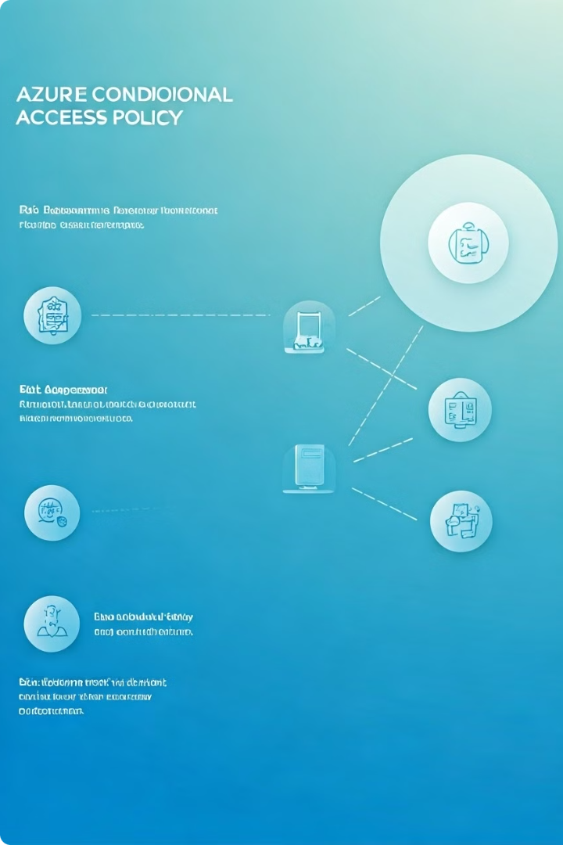



Implementing Conditional Access Policies with MFA
Assess Risks
Analyze your organization's security risks and identify the scenarios where MFA should be required, such as access from untrusted locations, use of unmanaged devices, or high-risk user activities.
Define Policies
Create Conditional Access policies that enforce MFA based on your identified risk factors, such as user, device, location, or application context. This ensures that the appropriate level of security is applied to each access request.
Monitor and Refine
Continuously monitor the effectiveness of your Conditional Access policies and make adjustments as needed to address evolving security threats and changes in your organization's requirements.

Slide 8
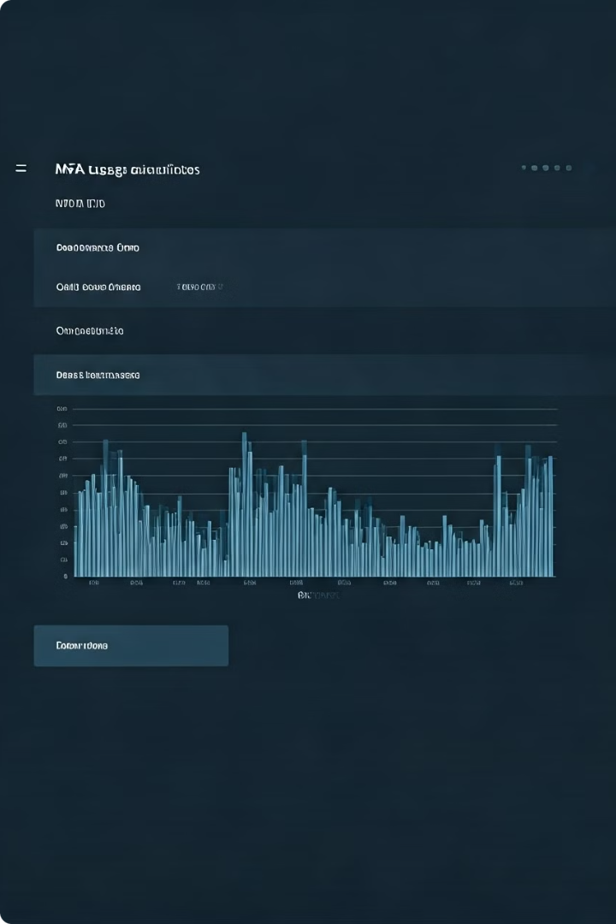
Monitoring and Reporting MFA Usage
Metric
Description
Importance
MFA Usage Rate
The percentage of users who have enabled and are using MFA.
Monitors the overall adoption and effectiveness of your MFA implementation.
MFA Challenge Attempts
The number of times users are prompted to complete MFA challenges.
Helps identify potential security issues or user friction points.
MFA Challenge Success Rate
The percentage of successful MFA challenges completed by users.
Indicates the usability and effectiveness of your MFA configuration.
Conditional Access Enforcement
The number of access requests that were blocked or challenged due to Conditional Access policies.
Demonstrates the impact of your Conditional Access policies in enhancing security.

Slide 9

Troubleshooting MFA Issues
1
User Enrollment Challenges
Provide clear guidance and support to users during the MFA enrollment process, as issues with setting up their preferred authentication method can lead to login failures and user frustration.
2
Authentication Method Failures
Monitor for any issues with specific authentication methods, such as SMS or push notifications, and make adjustments or provide alternative options to ensure a reliable user experience.
3
Conditional Access Policy Conflicts
Carefully review your Conditional Access policies to identify and resolve any potential conflicts or unintended consequences that may be causing access issues or user frustration.
4
Reporting and Analytics Gaps
Ensure that you have the necessary reporting and analytics capabilities to effectively monitor MFA usage, identify problems, and make informed decisions about your MFA configuration and policies.

Slide 10
Best Practices for Managing Azure MFA
Establish a Phased Rollout
Provide User Education
Regularly Review and Update
Educate your users on the importance of MFA and how to set up their preferred authentication methods. Ongoing communication and training will help increase user adoption and reduce support requests.
Implement MFA in a phased approach, starting with high-priority accounts or user groups, and gradually expanding to the rest of your organization. This allows you to monitor adoption, address any issues, and ensure a smooth transition.
Continuously monitor your MFA configuration and policies, and make adjustments as needed to address evolving security threats, organizational changes, and user feedback. This will help ensure that your MFA implementation remains effective and efficient.

